Slide 1
The Role of financing in sustainable infrastrcture
Zach Mohr, Guest Lecture
9/10/2018
UNC MPA and Public Policy PhD programs
Notes:
nfrastructure is:
Government’s capital assets
Immovable, stationary in nature
Preserved for a longer period. Ex: roads, sidewalks, bridges, tunnels, drainage systems, water and sewer systems, dams, lighting systems etc.

Slide 2
Point to ponder
$3.6 Trillion
  The amount of investment needed for America’s public infrastructure by 2020
  http://www.infrastructurereportcard.org/
Who will pay for it?
Notes:
Federal government budget is $4.1 Trillion; 88% of the federal budget

Slide 3
Learning Objectives
Who finances infrastructure?
How does the public sector finance public infrastructure?
How can we incorporate sustainability into public infrastructure financing?

Slide 4
Who finances infrastructure?
Private companies financing private projects
  I.E. Duke or Piedmont
  Increasingly governments selling infrastructure to reduce liability and increase private investment
  Are these “private” companies completely private?
Public/Government
  Federal - No real plan!
  State
  Local – Capital Investment Plan or Budget (aka CIP)
    http://charlottenc.gov/charlottefuture/cip/Pages/default.aspx

Slide 5
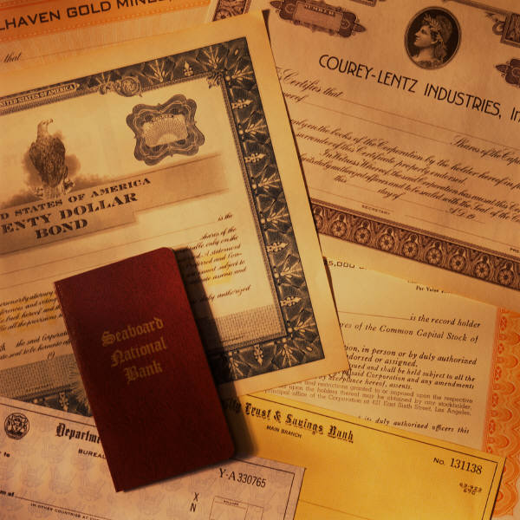
How is public infrastructure financed?
Financed:
  Tax-supported bonds
  Grants from other governmental units (e.g., Federal or state grants)
  Transfers from other funds
  Special assessment bonds or taxes
  Capital leases

Slide 6
How…
Tax supported bonds aka General Obligation Bonds or GO Bonds
  Lowest cost
  Supported by the full faith and credit of the jurisdiction
    Usually government has limits on GO debt
    Often requires bond referenda
      City of Charlotte and Mecklenburg County trade off with Bond Referenda
  Variety of bond issuance types
    Negotiated vs competitive
    Creditworthiness of issuer i.e. bond rating

Slide 7
How…
Federal and State Grants
  Great when available but…
    Federal government doesn’t have a capital budget
    States seem intent on taking assets from local governments
  Still major investments in some areas from federal and state

Slide 8
How…
Transfers from other funds
  Transfer from general fund
    Competes with tax supported services
    General fund often supports early project planning and design
  Sinking funds

Slide 9
How…
Special assessment bonds and special taxes
  Special assessments
    What are they?
    Often used in other states
  Special taxes
    Highway fund money
    i.e. earmarked sales taxes
Certificates of participation (COP)
  Private financing
  Not subject to same referenda and limitation as GO
  A lot like a lease

Slide 10
How…
Capital leases, lease purchases
  Lease - a contract by which one party conveys land, property, services, etc., to another for a specified time, usually in return for a periodic payment.
    Capital lease – lease that eventually ends; firetrucks
    Lease purchase – lease that leads to ownership; schools, water treatment plants, etc.
  Attractive because government can walk away
  Attractive to business because
    they don’t have to pay capital gains taxes
    Low default and stable customer base

Slide 11
How…
Private financing i.e. PPP and Public Private Partnerships –
  What is the big one happening here? Is it good?
  Other examples
    Turnpikes
    Parking meters
    All manner of utilities

Slide 12
How can we incorporate sustainability into finance?
What is sustainability?
  Triple bottom line
    Economic
    Environment
    Social
How do we incorporate sustainability?
  Better planning
  Good management
  Incorporate sustainability into finance

Slide 13
Better planning
The Kansas Turnpike (Includes the first portion of the federal Interstate system)
Built in 1956 (in just 22 months created a highway of over 200 miles) How long has 485 taken?
Ended abruptly in a farmer’s field in Oklahoma

Slide 14
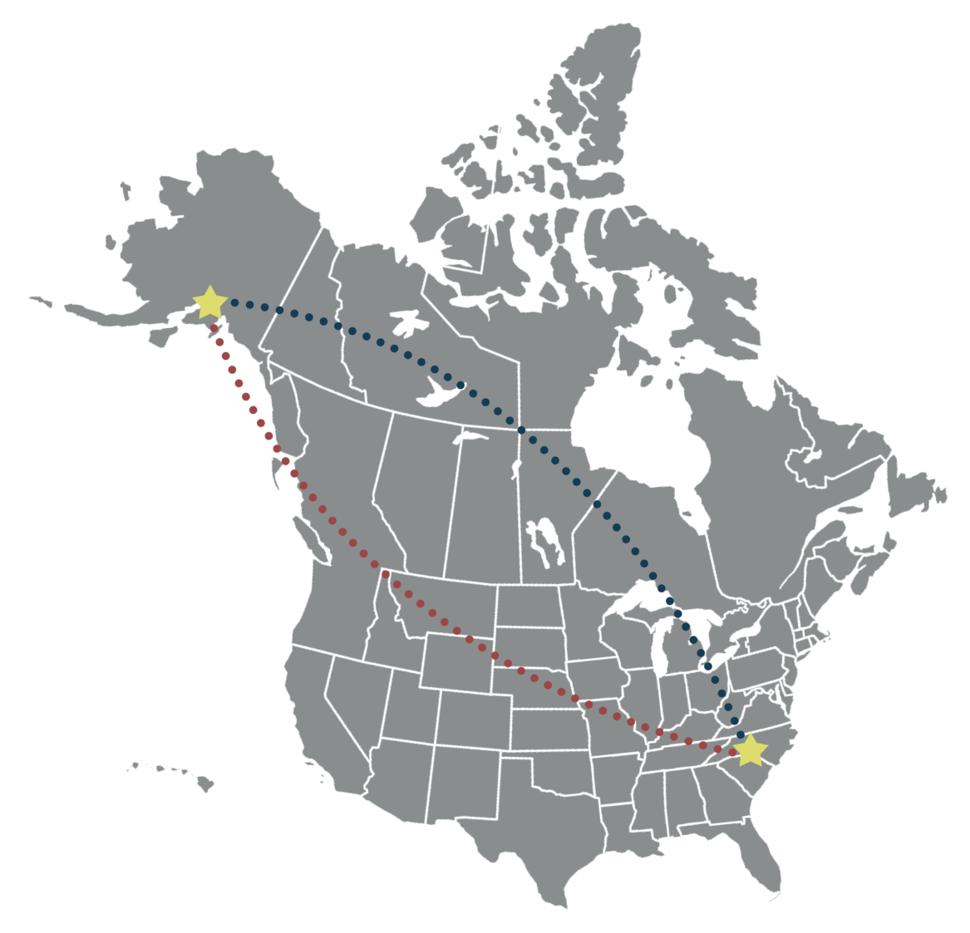
Good management
Charlotte Water has enough pipe to run from Charlotte to Anchorage, Alaska and back¹
Most assets donated
Notes:
1. Source Charlotte Water Twitter and Michael Tkachuk

Slide 15
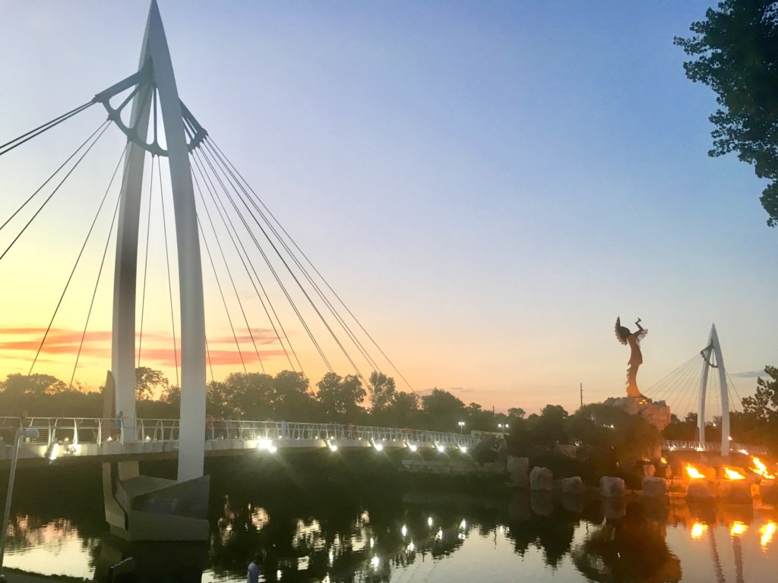
Incorporate sustainability into financing
Portion of taxes and bonds for sustainability
  Example art set-asides

Slide 16
Conclusion
How do we do this? How do we tackle this big problem?
Zach Mohr, zmohr@uncc.edu

