Slide 1
Chapter 6
Accounting for Income Taxes

Slide 2
Learning Objectives
Explain the objectives behind FASB ASC Topic 740, Accounting for Income Taxes, and the income tax provision process.
Calculate the current and deferred income tax expense or benefit components of a company’s income tax provision.
Recall what a valuation allowance represents and describe the process by which it is determined.

Slide 3
Learning Objectives (cont.)
Explain how a company accounts for its uncertain income tax positions under ASC 740-10 (a codification of FASB Interpretation (FIN) No. 48, Accounting for Uncertainty in Income Taxes).
Recognize the different components of a company’s disclosure of its income tax accounts in the financial statements and footnotes and comprehend how a company computes and discloses the components of its “effective tax rate.”

Slide 4
Objectives of “Accounting for Income Taxes” and Income Tax Provision Process
The income tax provision includes
  Current year taxes payable or refundable
  Any changes to future income taxes payable or refundable that result from differences in the timing of when an item is reported on the tax return compared to the financial statement
A company records these future income taxes payable or refundable on its balance sheet as
  Deferred tax liability
  Deferred tax asset

Slide 5
Objectives of “Accounting for Income Taxes” and Income Tax Provision Process
Objectives of ASC 740
  ASC 740 applies only to:
    Income taxes levied by the U.S. federal government
    U.S. state and local governments
    Non-U.S. (“foreign”) governments
  The FASB defines an income tax as a tax based on income, which excludes property taxes, excise taxes, sales taxes, and value-added taxes.
  Companies report non-income taxes as expenses in the computation of their net income before taxes

Slide 6
Objectives of “Accounting for Income Taxes” and Income Tax Provision Process
  Two objectives
    Recognize the amount of income taxes payable or refundable in the current year
    Recognize deferred tax liabilities and assets for the (expected) future tax consequences of events that have been recognized in an enterprise’s financial statements or tax returns
  Both objectives relate to reporting a company’s income tax amounts on the balance sheet, not the income statement
  Asset and liability approach

Slide 7
Objectives of “Accounting for Income Taxes” and Income Tax Provision Process
A “book-tax” difference can occur for several reasons:
  Different accounting methods are used in the computation.
    Straight-line depreciation is used for book, accelerated depreciation is used for tax.
  The book-tax “rules” are different.
    Not all book income is taxable.
    Not all book deductions reduce taxable income.
    Not all tax deductions reduce book income.

Slide 8
Objectives of “Accounting for Income Taxes” and Income tax Provision Process
  The timing of when income and deductions are reported on the two statements may differ (prepayments).
  Different entities may appear on the two statements.

Slide 9
Objectives of “Accounting for Income Taxes” and Income Tax Provision Process
To compute the deferred tax liability or asset, a company must calculate the future tax effects attributable to temporary differences and tax carry forwards
  Temporary differences that are initially favorable (unfavorable) create deferred tax liabilities (assets)

Slide 10
Objectives of “Accounting for Income Taxes” and Income Tax Provision Process
Steps in determining the income tax provision
  Adjust pretax income for permanent differences
  Identify all temporary differences and carryforwards
  Calculate the current income tax expense or benefit
  Recognize deferred tax assets and liabilities
  Evaluate the need for a valuation allowance for deferred tax assets
  Calculate the deferred income tax expense or benefit
  Determine changes to liabilities for uncertain tax positions

Slide 11
Objectives of “Accounting for Income Taxes” and Income Tax Provision Process
Income Tax Provision Process
  Compute the two components of the income tax provision
    Current
    Deferred
  Combine the two components to produce the total income tax provision
  Formula

Slide 12
Calculate Current and Deferred Income Tax Expense or Benefit Component
Adjust Pretax Net Income for All Permanent Differences
  Permanent differences - Differences that appear only on the income statement or tax return, but not on both
  A company does not take permanent differences into account in computing its deferred tax assets and liabilities
  Permanent differences usually affect a company’s effective tax rate and appear as part of its reconciliation of its effective tax rate with the statutory U.S. tax rate

Slide 13
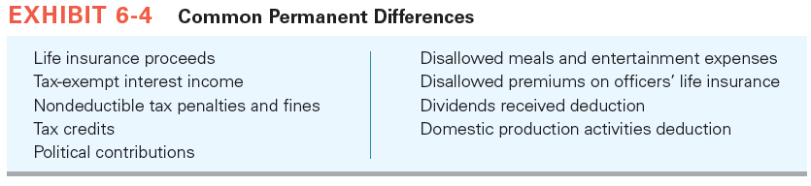
Calculate Current and Deferred Income Tax Expense or Benefit Components

Slide 14
Calculate Current and Deferred Income Tax Expense or Benefit Components
Identify All Temporary Differences and Tax Carryforward Amounts
  Temporary differences commonly arise in four instances
    Revenues or Gains that are taxable after they are recognized in Financial Income
    Expenses or Losses that are deductible after they are recognized in Financial Income
    Revenues or Gains that are taxable before they are recognized in Financial Income
    Expenses or Losses that are deductible before they are recognized in Financial Income

Slide 15
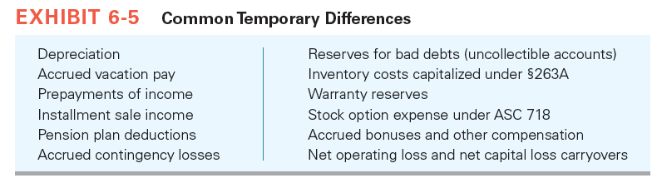
Calculate Current and Deferred Income Tax Expense or Benefit Components

Slide 16
Calculate Current and Deferred Income Tax Expense or Benefit Components
Identifying Taxable and Deductible Temporary Differences
  Taxable Temporary Difference
    Initially favorable gives rise to a taxable temporary difference
    Taxable temporary differences generally arise when
      Revenues or gains are taxable after they are recognized in net income
      Expenses or losses are deductible on the tax return before they reduce net income

Slide 17
Calculate Current and Deferred Income Tax Expense or Benefit Components
From a balance sheet perspective
  A taxable temporary difference generally arises when the financial reporting basis of an asset exceeds its corresponding tax basis, or the financial reporting basis of a liability is less than its corresponding tax basis
The future tax cost associated with a taxable temporary difference is recorded on the balance sheet as a deferred tax liability

Slide 18
Calculate Current and Deferred Income Tax Expense or Benefit Components
Deductible Temporary Difference
  A temporary difference that initially is unfavorable gives rise to a deductible temporary difference
  Deductible temporary differences generally arise when
    Revenues or gains are taxable before they are recognized in net income
    Expenses or losses are deductible on the tax return after they reduce net income

Slide 19
Calculate Current and Deferred Income Tax Expense or Benefit Components
From a balance sheet perspective
  A deductible temporary difference generally arises when the financial reporting basis of an asset is less than its corresponding tax basis or the financial reporting basis of a liability exceeds its corresponding tax basis
The future tax benefit associated with a deductible temporary difference is recorded on the balance sheet as a deferred tax asset

Slide 20
Calculate Current and Deferred Income Tax Expense or Benefit Components
Compute the Current Income Tax Expense or Benefit
  ASC 740 defines the current income tax expense or benefit as “The amount of income taxes paid or payable (or refundable) for a year as determined by applying the provisions of the enacted tax law to the taxable income or excess of deductions over revenues for that year”
  The major component of a company’s current income tax expense or benefit is
    income tax liability or
    refund from its current year operations

Slide 21
The Current Tax Provision Example
Green, Inc. computed its pretax book income to be $1,000. Green identified the following four book/tax differences that it will report on Schedule M-1 when it files Form 1120 later in the year.
  Tax-exempt interest income (book, not tax) 50 P
  Accrued warranty (book, not tax) (200) T
  Nondeductible fine (book, not tax) (150) P
  Tax depreciation in excess of book depreciation (100) T

Slide 22
The Current Tax Provision
  Compute taxable income
  Book income $1,000
  Tax-exempt interest income (50)
  Accrued warranty 200
  Nondeductible fine 150
  Tax depreciation in excess of book depreciation (100)
  Taxable income $1,200
  Compute the current tax provision (assume t = 35%)
  $1,200 × 35% = $420

Slide 23
Calculate Current and Deferred Income Tax Expense or Benefit Components
Determine the Ending Balances in the Balance Sheet Deferred Tax Asset and Liability Accounts
  The deferred income tax expense or benefit portion of a company’s income tax provision reflects the change in a company’s deferred tax liabilities or assets that relate to continuing operations
  The deferred tax accounts provide investors and other interested parties with a measure of a company’s expected future income tax related cash inflows (outflows) resulting from book-tax differences that are temporary in nature or from tax carryover

Slide 24
Calculate Current and Deferred Income Tax Expense or Benefit Components
ASC 740 takes a “liability” or balance sheet approach for the computation of the deferred tax expense or benefit
The computations are based on the change in the cumulative differences between the financial accounting basis of an asset or liability and its corresponding tax basis from the beginning of the year to the end of the year

Slide 25
Determining Whether a Valuation Allowance is Needed
Evaluate the Need for a Valuation Allowance for Gross Deferred Tax Assets
  A valuation allowance is required if it is more likely than not some or all of the deferred tax asset will not be realized in the future
  ASC 740 identifies four sources of potential future taxable income, two of which are objective and other two are subjective

Slide 26
Determining Whether a Valuation Allowance is Needed
Objective sources
  Future Reversals of Existing Taxable Temporary Differences
    If the reversing taxable temporary differences provide sufficient future taxable income to absorb the reversing deductible temporary differences, the company does not record a valuation allowance against the deferred tax asset

Slide 27
Determining Whether a Valuation Allowance is Needed
  Taxable Income in Prior Carryback Years
    Company does not record a valuation allowance if the tax benefit from the realization of a deferred tax asset can be carried back to a prior year that has sufficient taxable income to absorb the realized tax benefit.

Slide 28
Determining Whether a Valuation Allowance is Needed
Subjective sources
  Expected future taxable income exclusive of reversing temporary differences and carryforwards
    A company might support its predictions of future taxable income with evidence of existing contracts or a sales backlog that will produce enough taxable income to realize the deferred tax asset when it reverses

Slide 29
Determining Whether a Valuation Allowance is Needed
  Tax Planning Strategies
    Includes sale and leaseback of operating assets
    Changing inventory accounting methods
    Refraining from making voluntary contributions to the company pension plan
    Electing to capitalize certain expenditures rather than deduct them currently
    Sale of noncore assets
    Electing the alternative depreciation system

Slide 30
Determining Whether a Valuation Allowance is Needed
Negative Evidence That a Valuation Allowance Is Needed
  ASC 740 requires that a company consider negative as well as positive evidence in determining whether it is more likely that a deferred tax asset will not be realized in the future.
  Negative evidence includes
    Cumulative (book) losses in recent years (usually 36 quarters)
    A history of net operating (capital) losses and credits expiring unused

Slide 31
Determining Whether a Valuation Allowance is Needed
    An expectation of losses in the near future
    Unsettled circumstances that, if resolved unfavorably, will result in losses from continuing operations in future years
Calculate the Deferred Income Tax Expense or Benefit

Slide 32
Accounting for Uncertainty in Income Tax Positions
FAS 109 provided no specific guidance on how to deal with uncertain tax positions.
Companies generally applied the principles of FAS 5, Accounting for Contingencies, to uncertain tax positions.
The objective of FIN 48 (codified in ASC 740-10) was to provide a uniform approach to recording and disclosing tax benefits resulting from tax positions that are considered to be uncertain.

Slide 33
Accounting for Uncertainty in Income Tax Positions
ASC 740-10 applies to all tax positions accounted for in accordance with ASC 740, including:
  Previously filed positions
  Expected filing positions
  Decisions not to file tax returns in a particular jurisdiction
  Decisions to exclude potentially taxable income
  Choices made in classifying a transaction as tax-exempt or taxable

Slide 34
Accounting for Uncertainty in Income Tax Positions
ASC 740-10 applies a two step process in evaluating tax positions
  Recognition process
    Company first determines if it is more likely than not that its tax position on a particular account will be sustained on IRS examination based on its technical merits
    Company then determines the amount it expects to be able to recognize

Slide 35
Accounting for Uncertainty in Income Tax Positions
  Measurement process
    Requires the company to make a cumulative probability assessment of all likely outcomes of the audit and litigation process
      A company recognizes the amount that has a greater than 50 percent probability of being sustained on examination and subsequent litigation
      The amount not recognized is recorded as a liability on the balance sheet
Interest and Penalties – may be included in the provision or reported as a deduction in computing pretax income

Slide 36
Accounting for Uncertainty in Income Tax Positions
Disclosures of Uncertain Tax Positions
  Specific line items should disclose
    Gross amounts of increases and decreases in liabilities related to uncertain tax positions as a result of tax positions taken during a prior period and current year
    Amounts of decreases in liabilities related to uncertain tax positions relating to settlements with taxing authorities
    Reductions in liabilities related to uncertain tax positions as a result of a lapse of the applicable statute of limitations

Slide 37
Financial Statement Disclosure and Corporation's Effective Tax Rate
Balance Sheet Classification
  ASC 740 requires companies (public and private) to disclose their deferred tax assets and liabilities on their balance sheets and classify them as either current or noncurrent (all are noncurrent beginning in 2016).
  ASC 740 permits companies to net deferred tax assets and liabilities based on their classification and present the net amount on the balance sheet
  ASC 740 does not permit netting of deferred tax assets and liabilities that are attributable to different tax jurisdictions

Slide 38
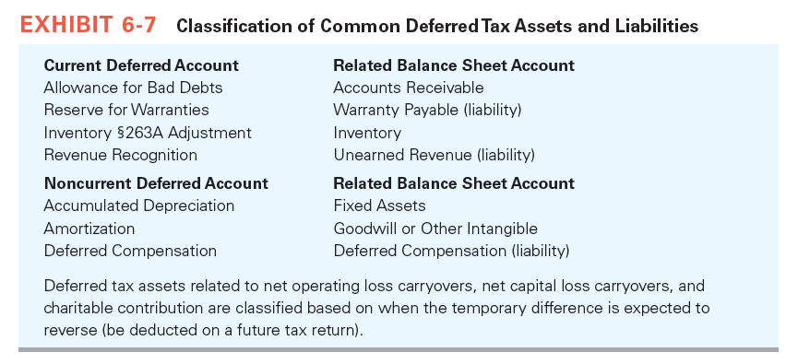
Financial Statement Disclosure and Corporation's Effective Tax Rate

Slide 39
Financial Statement Disclosure and Corporation's Effective Tax Rate
Income Tax Footnote Disclosure
  ASC 740 mandates that a company disclose
    Components of the net deferred tax assets and liabilities reported on its balance sheet
    Total valuation allowance recognized for deferred tax assets
ASC 740 also requires publicly traded companies to disclose these components
  Current tax expense or benefit
  Deferred tax expense or benefit

Slide 40
Financial Statement Disclosure and Corporation's Effective Tax Rate
  Benefits of operating loss carryforwards
  Adjustments of a deferred tax liability or asset for enacted changes in tax laws or rates
  Adjustments to the beginning of-the-year balance of a valuation allowance because of a change in circumstances that causes a change in management’s judgment about the realizability of the recognized deferred tax assets

Slide 41
Financial Statement Disclosure and Corporation's Effective Tax Rate
Computation and Reconciliation of the Income Tax Provision with a Company’s Hypothetical Tax Provision
  ASC 740 requires a company to reconcile its
    Reported income tax provision attributable to continuing operations with
    Amount of income tax expense that would result from applying its U.S. statutory tax rate to its pretax net income or loss from continuing operations

Slide 42
Financial Statement Disclosure and Corporation's Effective Tax Rate
Importance of a Company’s Effective Tax Rate
  The tax rate that backs out one-time and nonrecurring (discrete) events is referred to as the company’s structural tax rate
  The structural effective tax rate often is viewed as more representative of the company’s effective tax rate from its normal (recurring) operations
  The cash tax rate is used by analysts to compute a company’s tax status excluding deferred taxes

